Slide 1
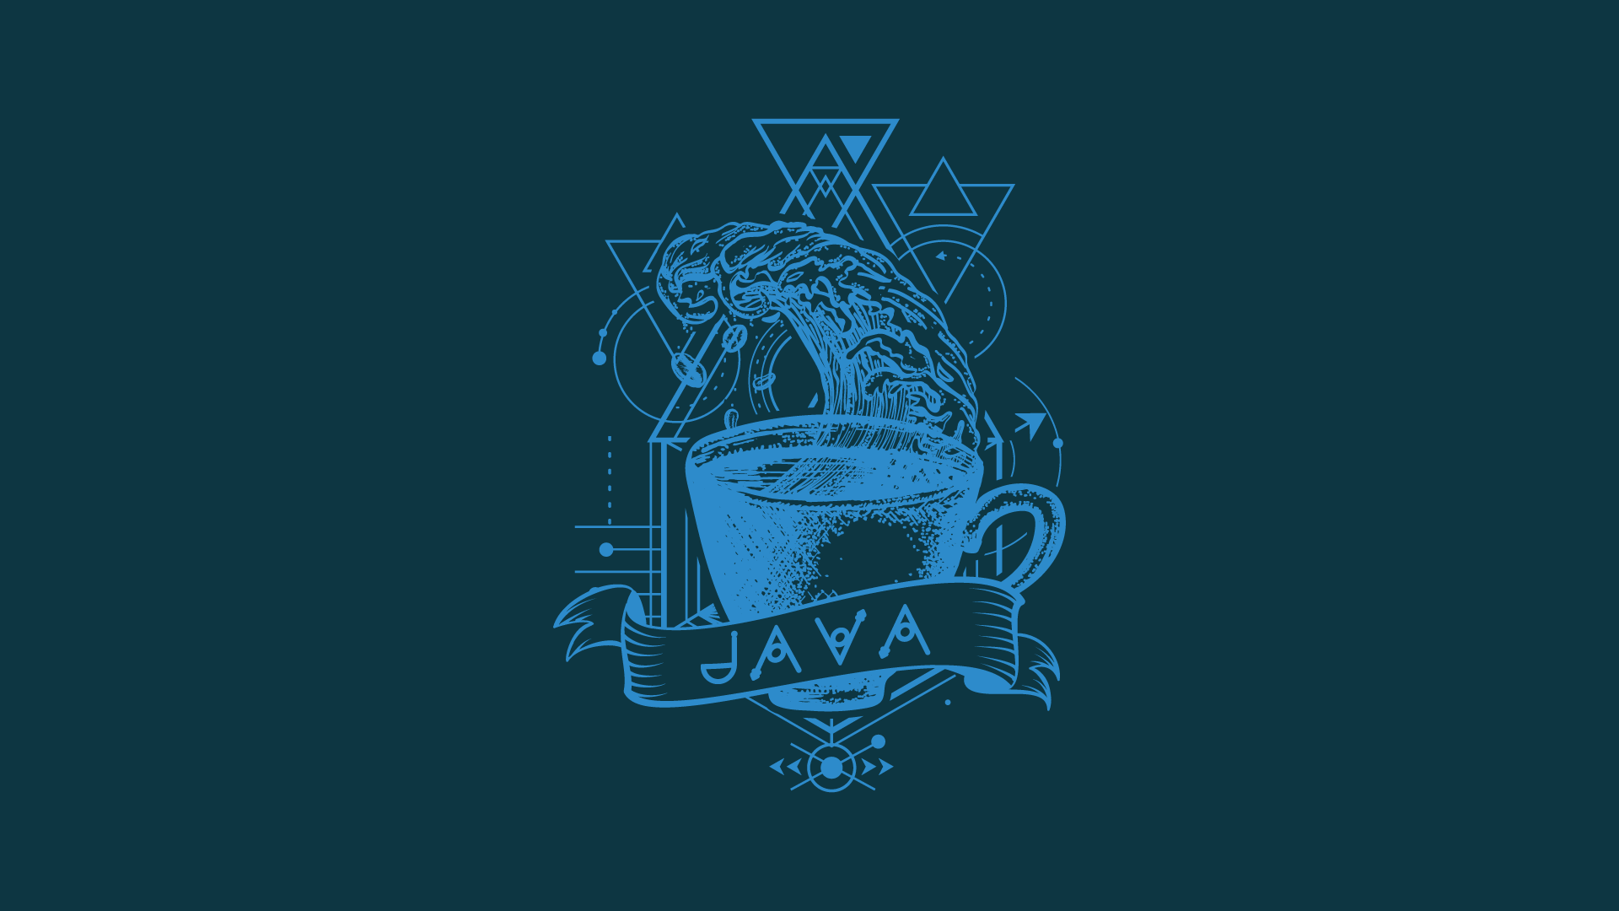

Shri Ram College Of Engineering & Management, Palwal
Department of Computer Science of Engineering
Presentation
ON
“Introduction ofJAVA”
Presented By
KISHAN Kumar RAI

Slide 2
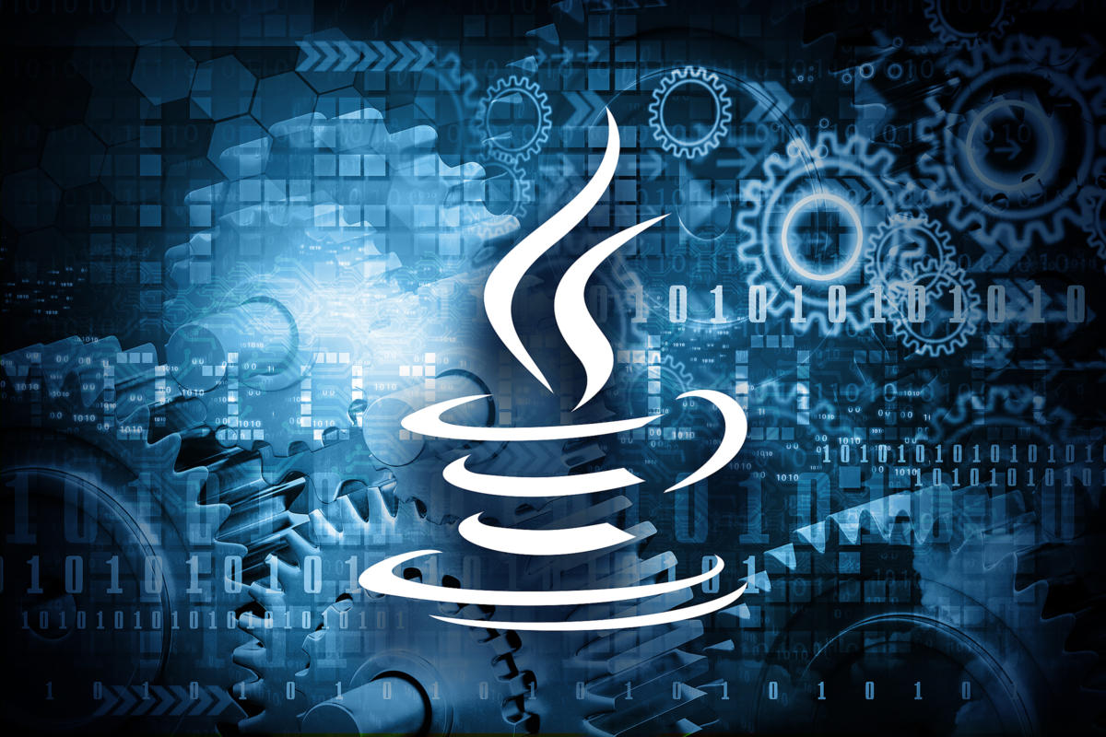
INTRODUCTION TO JAVA

Slide 3
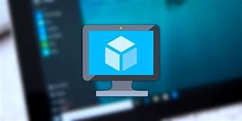
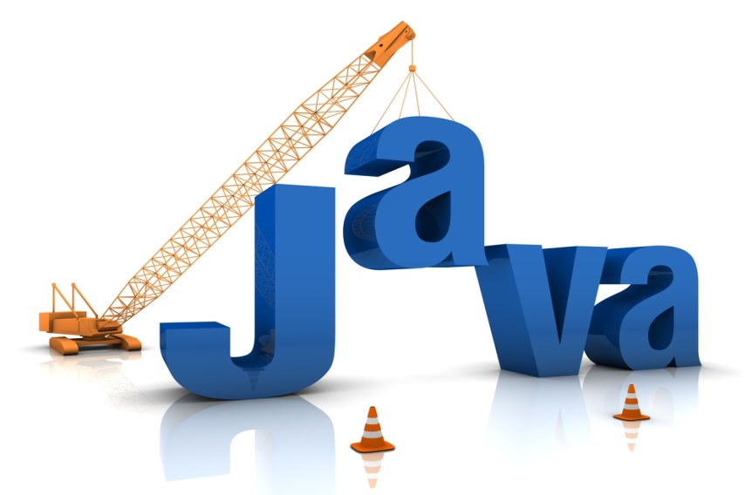
CONTENTS:-
What is java
How to write Program
History of java
Features of java
How its work
Where is java used
java virtual machine
Object oriented programming(OOP)
Conculsion

Slide 4

What is java….?
Java is a high level Programming language .
It is based upon the concept of object oriented.
Java is a object oriented programming so we have to develop an object. An object is basically developed by means of defining a class.
Java is a platform because it has its own runtime environment that is JVM.
Java is a case sensitive language like C and C++.

Slide 5
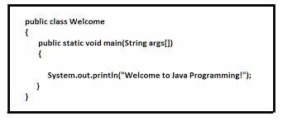
How to Write program

Slide 6
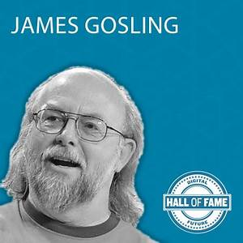
History of java….!
Java was developed by James Gosling at sun Microsystems, who is known as the father of Java, in 1995.
James Gosling and his team members started the project in the early '90s
The history of Java starts with the Green Team
Before java its name is Oak

Slide 7
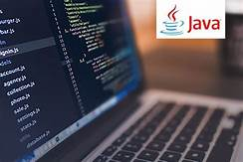
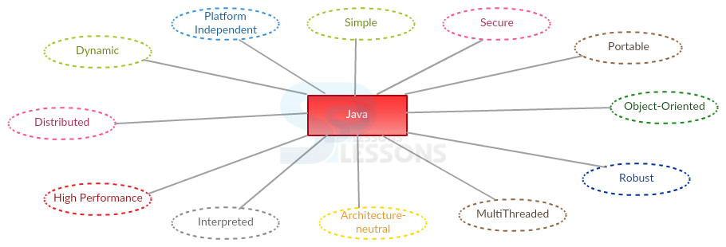
Features of java….!

Slide 8

How its work……?
Java is independent
Only for one reason
Only depends on the java virtual Machine(JVM)
Code is complied to byte code which is interpreted by the resident JVM,
JIT(Just in time) compilers attempt to increase speed.

Slide 9
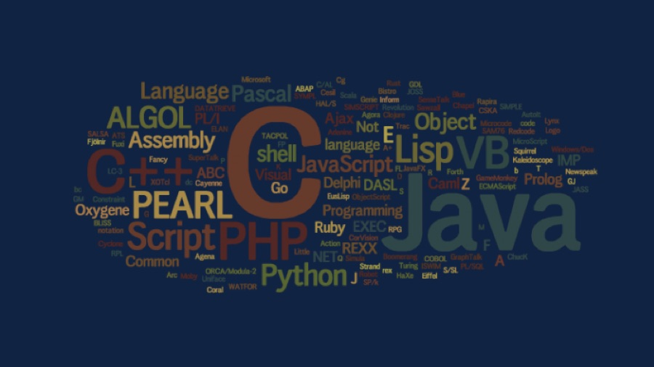
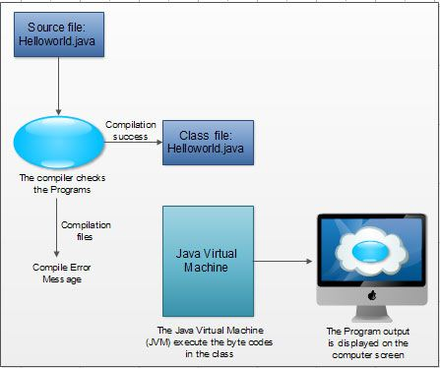
DIAGRAM…!

Slide 10
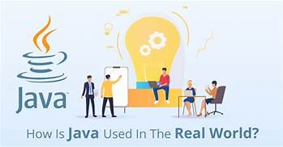
Where is java used…??
According to the sun,3 billons devices run java.
There are many devices where java is currently
Used:-
MOBILE
GAMES
ROBOTICS
WEB Applications , etc

Slide 11
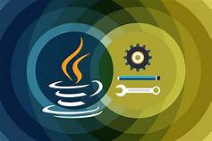
Java virtual machine
Java virtual machine is the like usual computer which translate high level language into machine language.
Just like that java virtual machine also translate byte code into machine language.
JVM are available for many hardware and software platform

Slide 12
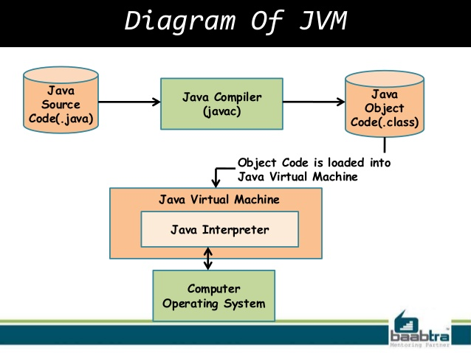

Slide 13
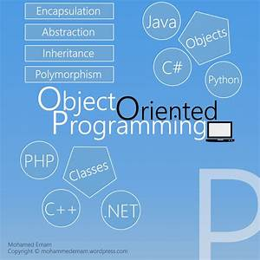
Object oriented programming(OOP)
Object-oriented programming is a method of implementation.
A language in which everything represent in the form of object is called object-oriented programming language.
Java is not truly object oriented programming language.
It not only makes the program less complex but also makes the software reuse feasible and possible.

Slide 14
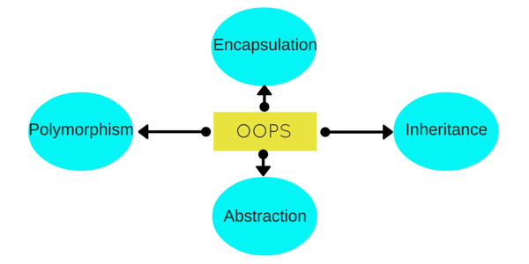

Slide 15

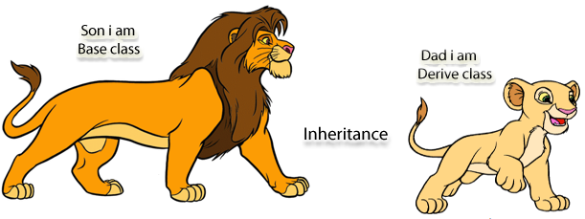
Inheritance
Inheritance is a mechanism, in which one class inherits the property of other class.

Slide 16
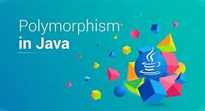
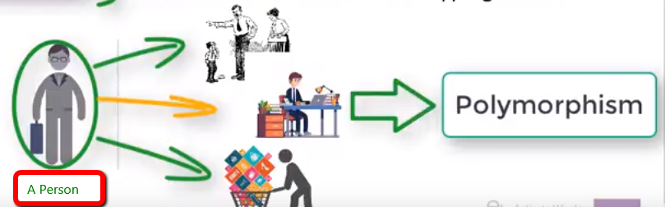
Polymorphism
MEANS
Many forms
In the real world , the same operation may have different meaning in different situations.

Slide 17
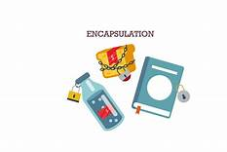
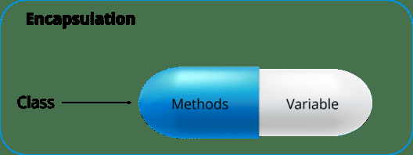
Encapsulation
The wrapping up of data and functions into a single unit.
It is also known as information hiding concept.

Slide 18
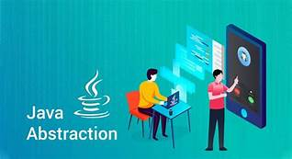
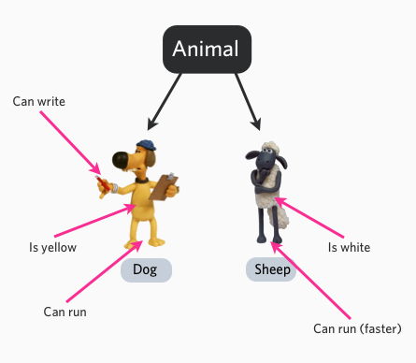
Abstraction
Is used for hiding the
unwanted data and
Giving relevant data.

Slide 19

Conclusion
Java offers the real possibility that most programs can be written in a type-safe language.
However , for java to be broadly useful, it needs to have expressive power than it does at present.

Slide 20
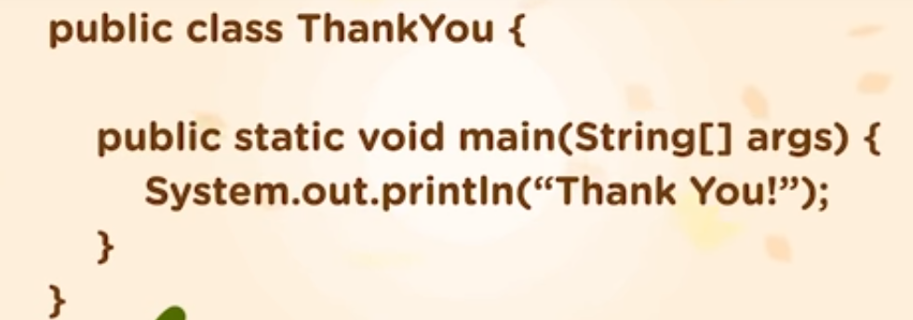
THANK YOU

Slide 21
